Slide 1

SRM INSTITUTE OF SCIENCE AND TECHNOLOGY RAMAPURAM FACULTY OF ENGINEERING AND TECHNOLOGY DEPARTMENT OF INFORMATION TECHNOLOGY 18CSP109L-Major Project Second Review Fake Product Detection in E-Commerce Platforms Using Block-Chain Technology
ATHIRA.P - RA2111008020123
SREE DURGA DEVI.S - RA2111008020135
ANISHA.K - RA2111008020151
Dr. K. Danesh
Assistant Professor

Slide 2
ABSTRACT
E-commerce platforms face a significant challenge with counterfeit products that deceive customers and damage brands. The rise of counterfeit products threatens businesses' reputations and consumers' safety. This project demonstrates how blockchain ensures a secure and transparent system for authenticating products. We propose a blockchain-based system using smart contracts to register products and generate unique digital identities. Consumers can verify authenticity by scanning QR codes, reducing fraud and enhancing trust. While blockchain improves transparency and security, challenges like scalability and interoperability remain. Overall, this study highlights blockchain's potential in combating counterfeit goods through decentralization and automation.
Key Words: Blockchain, Decentralized, Ethereum, Smart Contract, Counterfeited Product, QR Code

Slide 3
PROBLEM STATEMENT
Counterfeit goods significantly harm the trust between buyers and sellers, pose safety risks (especially in products like children's toys and medical supplies), and result in reputational damage, financial losses, and other legal Challenges. Manual verification and centralized databases are inefficient and vulnerable. This project leverages blockchain, smart contracts, and digital identities to create a decentralized, tamper-proof counterfeit detection system.
PURPOSE:
As the e-commerce industry continues to grow, counterfeit products have become a significant problem for consumers and businesses alike. Counterfeit products not only lead to financial losses but also endanger consumer health and safety. This project is crucial as it helps mitigate these issues by providing a blockchain-powered solution with smart contracts and QR-based verification to enhance transparency, ensure authenticity, and reduce fraud in digital and physical marketplaces.

Slide 4
KEY OBJECTIVES
To Develop a blockchain-based solution that guarantees immutability by securely recording product data using cryptographic hashing.
To Provide a tamper-proof system that prevents unauthorized modifications, ensuring data integrity and security.
To Provide a reliable product verification mechanism that enhances authenticity and trust in counterfeit detection.
To increase consumer confidence in online shopping by reducing the presence of fake products.

Slide 5
SCOPE
INCLUDED:
Fake product detection using Blockchain, Smart Contracts, and QR Code authentication.
Real-time verification of product authenticity through a decentralized ledger.
Secure product registration and tracking via unique digital identities.
Consumer-friendly authentication using QR code scanning.
Tamper-proof records ensuring transparency and trust in e-commerce transactions.
EXCLUDED:
Direct integration with specific blockchain networks (generalized model instead).
Fake product detection in non-digital domains (e.g., physical store-only verification).
Legal enforcement of counterfeit regulations (focus is on technology-based detection).
Cross-platform interoperability challenges beyond the proposed model’s scope.
AI-driven image recognition for product verification (focus is on blockchain authentication).

Slide 6
LITERATURE SURVEY
S.No | Paper Title | Publication Details | Author Name | Limitations | Challenges
1 | Fake Product Detection using Blockchain | IEEE Access 2020 | Tejaswi ambe, Sonali Chitkala | Limited Coverage | Data Accuracy
2 | Detection of Counterfeit Products using Blockchain | IRJMETS 2022 | Kunal Won-Shik, Isha Sondawale | Cost | Privacy and confidentiality
3 | Blockchain based product identification system. | ITM Web of Conference 2022 | M.Suhana S. Sujatha | Less Secure | Privacy and confidentiality
4 | Anti-Counterfeiting Blockchain Using a Truly Decentralized, Dynamic Consensus Protocol | PDX Scholar | Naif Alzahrani, Nirupama Bulusu | Technical Complexity | Complexity of algorithm
5 | Identifying Counterfeit Products using Blockchain Technology in Supply Chain System | IJARIIE 2022 | Pramit Dutta | Technical Complexity | Scalability
6 | A Blockchain-Based Fake Product Identification System | IEEE 2022 | Yasmeen Dabbagh, Reem Khoja | Cost | Efficiency

Slide 7
EXISTING SYSTEM
In the present systems for counterfeit product detection rely on a mix of manual inspections and automated techniques. Counterfeit products cause financial losses, brand damage, and safety risks, forcing businesses to invest heavily in anti-counterfeiting measures. Existing solutions use QR codes and barcodes for product verification, but they lack a secure and tamper-proof mechanism. Though effective, these systems face challenges with scalability, accuracy, and adapting to evolving counterfeit tactics. Without a decentralized system, consumers depend on merchants for product authenticity, increasing the risk of fraud. Further development is needed for real-time, reliable detection.

Slide 8
PROJECT REQUIREMENTS
Programming Languages: Python (processing, blockchain)
Frameworks: Web3.js, Flask / FastAPI(backend), React.js (frontend)
Blockchain Tools: Ethereum, Hyperledger Fabric
Databases: MongoDB (for storing product information and user feedback)
API & Libraries: Qr Code API, OpenCV/ TensorFlow
Libraries: Pandas, NumPy, Scikit-learn (for data processing and analysis)
Hardware: QR Code Scanner (optional).
Testing & Deployment: Postman, Jest / Mocha, Docker.
Smart Contracts: Solidity, Hardhat / Truffle, OpenZeppelin.

Slide 9
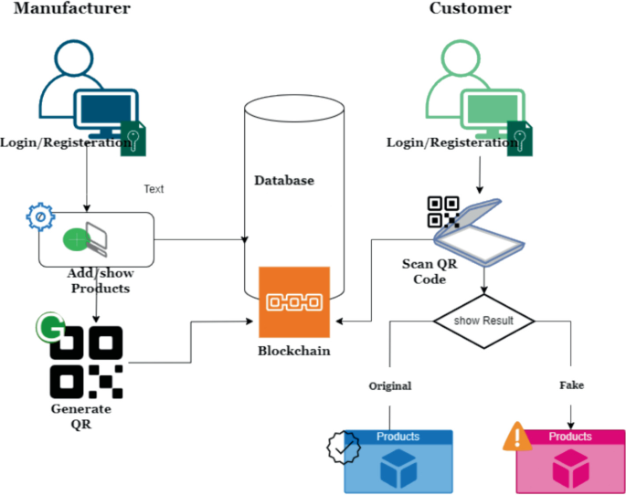
PROJECT ARCHITECTURE

Slide 10
PROJECT MODULES
User Authentication & Registration:
Secure login with MFA and role-based access control for buyers and sellers.
Product Registration via Blockchain:
Assigns a unique digital identity to products with immutable smart contract records.
QR Code Generation & Verification:
Generates blockchain-linked QR codes for secure and tamper-proof product authentication.
Decentralized Product Ledger:
Maintains a transparent, tamper-proof distributed ledger for product tracking.
Smart Contract Execution:
Automates trustless product validation and secure transactions using Ethereum smart contracts.
Counterfeit Detection Mechanism:
Detects fake products using blockchain verification and AI-powered analysis.
E-commerce Platform Integration:
Seamlessly connects blockchain verification with online marketplaces via APIs.
Analytics & Reporting Dashboard:
Provides real-time counterfeit detection insights and data-driven reports for manufacturers.

Slide 11
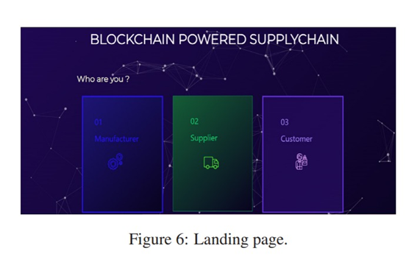
PROJECT IMPLEMENTATION

Slide 12
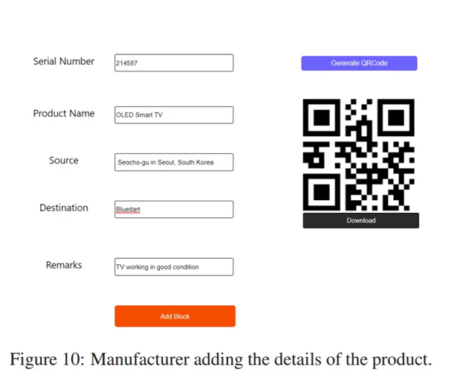
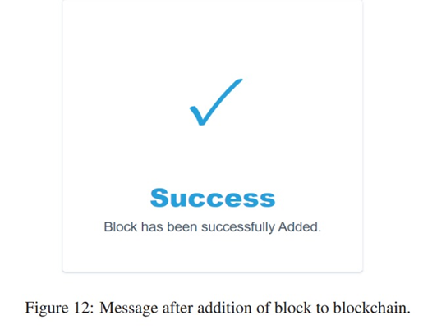
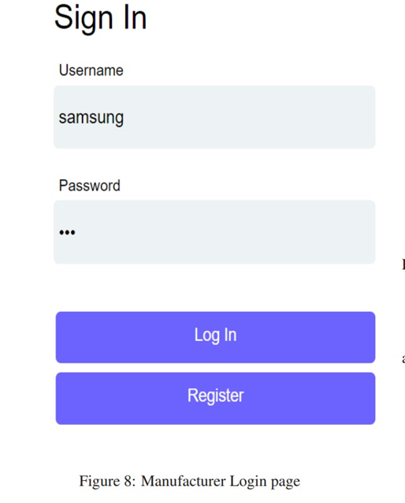
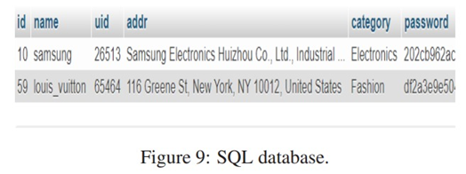
PROJECT IMPLEMENTATION

Slide 13
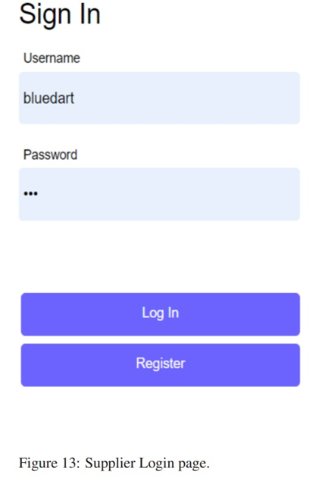
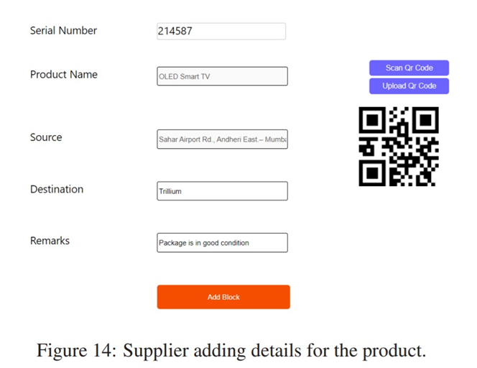
PROJECT IMPLEMENTATION

Slide 14
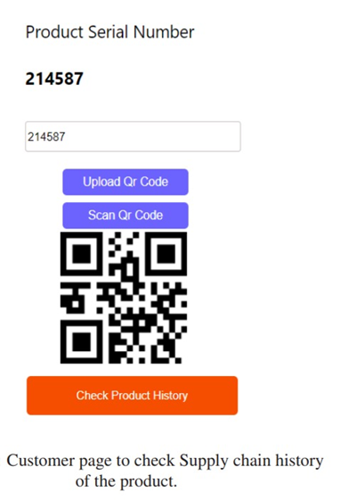
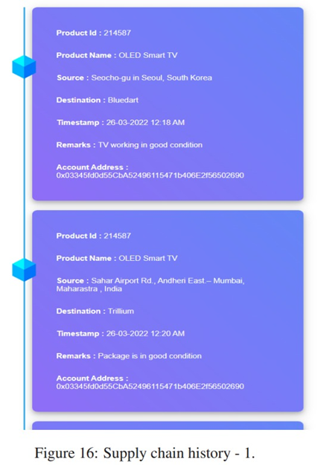
PROJECT IMPLEMENTATION

Slide 15
CONCLUSION
Overall, this blockchain technology-based application can emerge as a life saver for the companies and provide a new system for trading, marking and purchasing which is more secure and user-friendly. Our blockchain-based anti-counterfeiting system offers a cost-effective and secure solution for industries with limited resources, ensuring consumer trust in product authenticity. By leveraging Ethereum’s distributed applications, the system enhances transparency while maintaining affordability. Future improvements can focus on simplifying code to boost consumer confidence and integrating company APIs for efficient product data management. To prevent QR code duplication, secure graphic QR codes can be implemented, ensuring data integrity upon photocopying. Hence, this application strengthens counterfeit detection and improves security in e-commerce.

Slide 16
REFERENCES
[1] Abhinav Sanghi, Aayush, Ashutosh Kata war, Anshul Arora, Aditya Kaushik, “Detecting Fake Drugs using Blockchain”, International Journal of Recent Technology and Engineering (IJRTE) ISSN: 2277-3878, Volume-10 Issue-1, May 2021.
[2]. Miguel A. Prada-Delgado, Gero Ditt mann, Ilie Circular, Jens Jelte “A blockchain-based crypto-anchor platform for interoperable product authentication”, EEE International Symposium on Circuits and Systems (ISCAS),2021.
[3]. Mrs. S. Thejaswini , Ranjitha K R, “Blockchain in Agriculture by using Decentralized Peer to Peer Networks”, Proceedings of the Fourth International Conference on Inventive Systems and Control (ICISC 2020),2020.
[4] S. Chen, R. Shi, Z. Ren, J. Yan, Y. Shi, J. Zhang, A blockchain-based supply chain quality management framework, in 2017 IEEE 14th International Conference on e-Business Engineering (ICEBE) (IEEE, 2017), pp. 172–176 .
[5] Vinayak Singla, Indra Kumar Malav, Jaspreet Kaur and Sumit Kalra, “Develop Leave Application using Blockchain Smart Contract”, 11th international conference on Communication Systems and Networks,2019.
[6] Jesus Maximo Montes, Cecilia E. Ramirez, Manuel Coronado Gutierrez, Victor M. Larios, “Smart Contracts for supply chain applicable to Smart Cities daily operations”5th IEEE International Smart Cities Conference (ISC2 2019), 2019.
[7] Sanjay K. S, Dr. Ajit Danti “Detection of fake opinions on online products using Decision Tree and Information Gain” Third International Conference on Computing Methodologies and Communication (ICCMC 2019),2019.

Slide 17
THANK YOU

